Slide 1



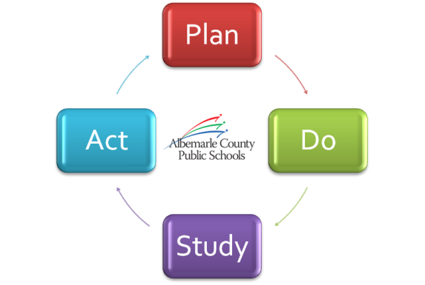


A Look at Our Strategic Performance
2011-12 Q4/EOY Progress Summary
July 12, 2012

Slide 2
Goal 1
Lifelong Learning
Learning Spaces
Goal 2
Performance Tasks
Goal 3
Engagement
Goal 4
Goal 5
Alignment and Improvement
Communications
Program Evaluation
Technology and Information Systems
Teacher Performance Appraisal
Recruitment and Retention

Slide 3
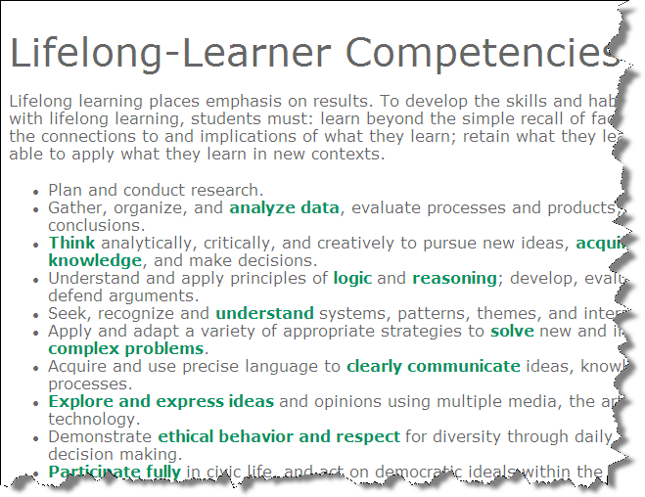
Goal 1
Lifelong Learning
76% of Learning Walks
32% of surveyed high school students

Slide 4
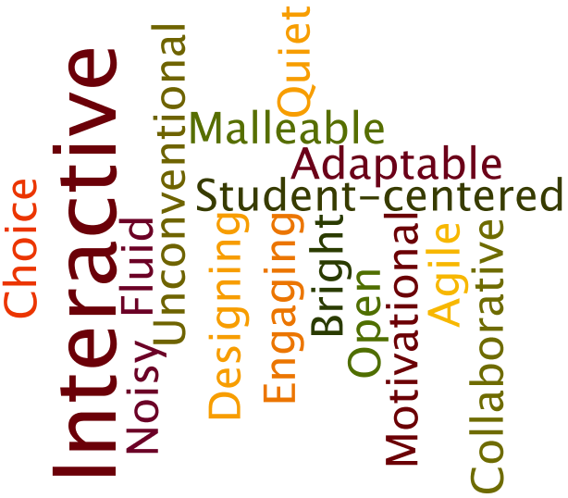
Goal 1
Learning Spaces
Developing shared meaning
Aligning systems:
TPA
Ed Tech Plan
CIP

Slide 5

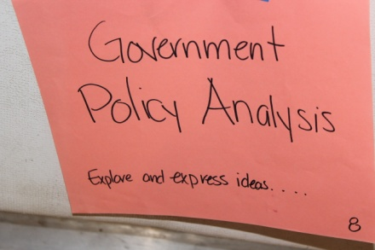
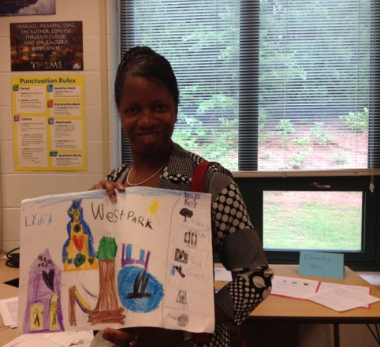
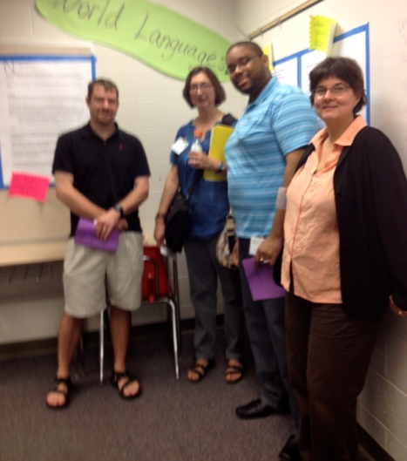
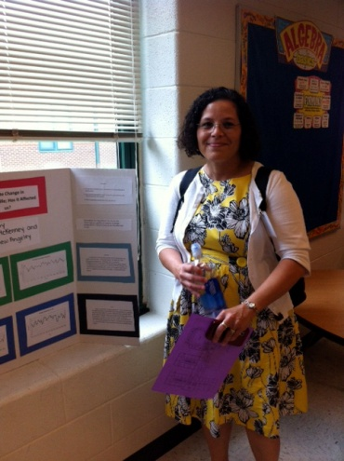
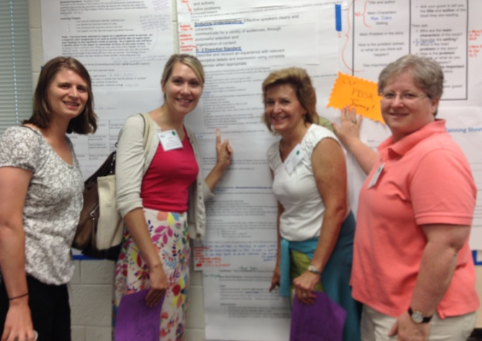
Goal 2
Performance Tasks
CAI 2012

Slide 6
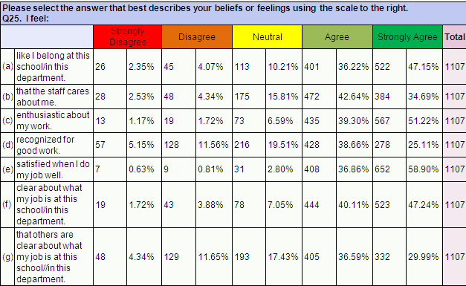

Goal 3
Engagement
Teacher Performance Appraisal
Recruitment and Retention
Updated
Engagement Survey Feedback from Over 1,000 Employees
Teacher Performance Appraisal
Social Media
for Recruitment

Slide 7


Goal 4
Alignment and Improvement
Communications
Incorporated
into TPA
Alignment of SIPs and DIPs

Slide 8
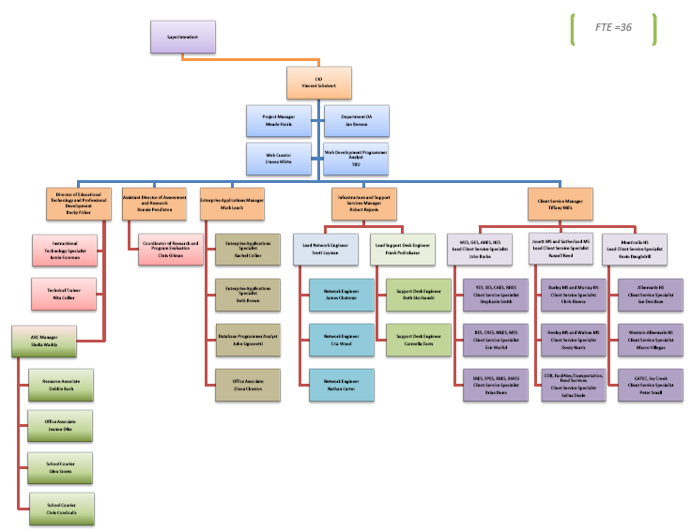
Goal 5
Program Evaluation
Technology and Information Systems
Instructional Program Evaluation
DART Efficiency Review
Which PROGRAMS are moving our students forward?
What is our EVIDENCE?

Slide 9



Our Departments
Title One
K1 PALS Assessment
Water Usage
On-Time Bus Arrivals

Slide 10
Looking Forward
Performance Tasks
for All Students
Academic Excellence Scorecard
Lifelong Learning
Hearing from our Students
Vision
Mission
Goals
Contemporary Learning Spaces
ALL Schools
Employee Recognition

Slide 11
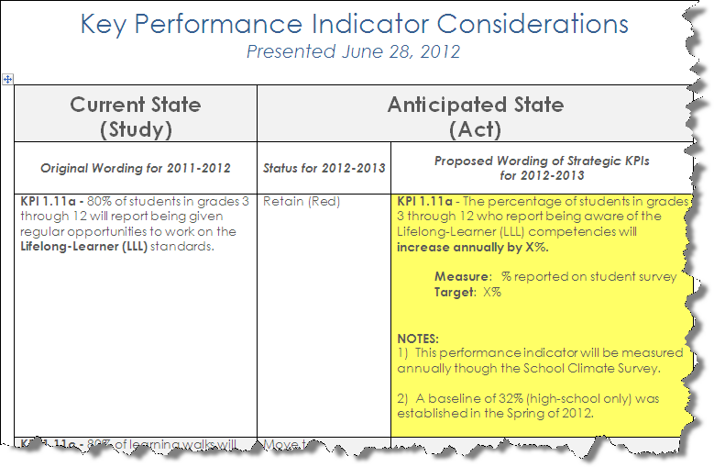
Fine Tuning our KPIs

Slide 12

Taking a “Deep Dive” into
Strategic Focus Areas
2012-13 Board Work Sessions
Our Schools & Departments talk about…
Lifelong Learning
Performance Tasks
Workforce Engagement
Vision, Mission, Goals
Program Evaluation & Valuation
Academic Excellence
Learning Spaces
Continuous Improvement
Strategic Communications

Slide 13
Proposal for
Strategic Plan Review Timeline
Phase 1: Create Awareness
July - September
Phase 2: Gather Feedback from Stakeholders
October - March
Phase 3: Synthesize Feedback and Refine Strategic Plan
April - June
Notes:
Link to Word document with full table of recommendations.

